Slide 1
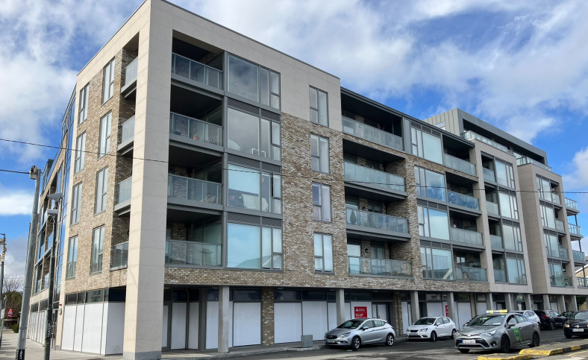
Adelaide road, bray
Adelaide Road, Bray
To let
Property Highlights
Excellent retail opportunities situated along the prominent Adelaide Road in Bray, comprising of three units in total.
Unit 1 extends to approximately 1,186 sq ft (110.21 sq m).
Unit 2 extends to approximately 1,582 sq ft (147 sq m).
Unit 3 extends to approximately 1,688 sq ft. (155 sq m).
6 car spaces available.
Contact
Location
The units boast a prominent location on Adelaide Road. The units benefit from their close proximity to Bray town centre, only a 10-minute walk.
Furthermore, the area offers a range of local amenities and is well supported by an excellent public transport network, including multiple Dublin Bus route in addition to the DART. The N11/M11 and M50 are only a short drive (2km), providing easy access to Dublin City Centre
Peter Love
Email: Peter.Lov@cushwake.com
Tel: +353 1 639 9612
Anna May Gilsenan
Email: AnnaMay.Gilsenan@cushwake.com
Tel: +353 86 833 9396

Slide 2
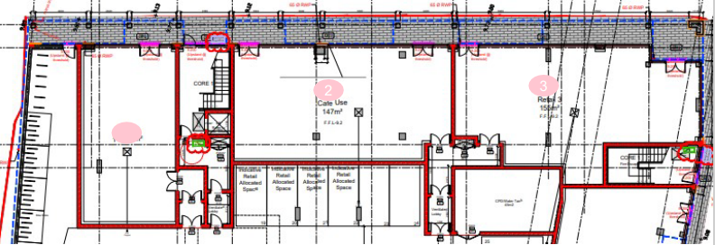
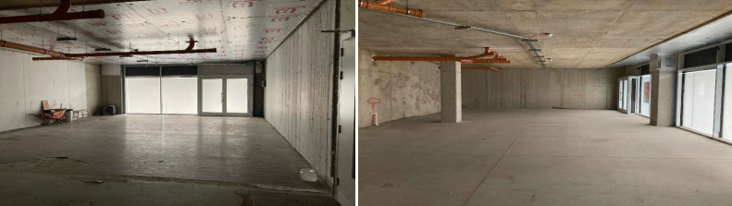
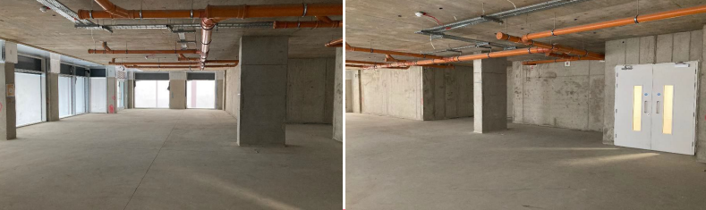
Adelaide Road, Bray
Property description
Adelaide Road presents excellent retail opportunities comprising of three retail units in total.
Unit 1 has planning permission for retail use, with the unit extending to approximately 1,186 sq. ft.
Unit 2 currently has planning permission for café use with the unit extending to approximately 1,582 sq f t.
Unit 3 has planning permission for retail use, with the unit extending to approximately 1,668 sq. f t.

Slide 3
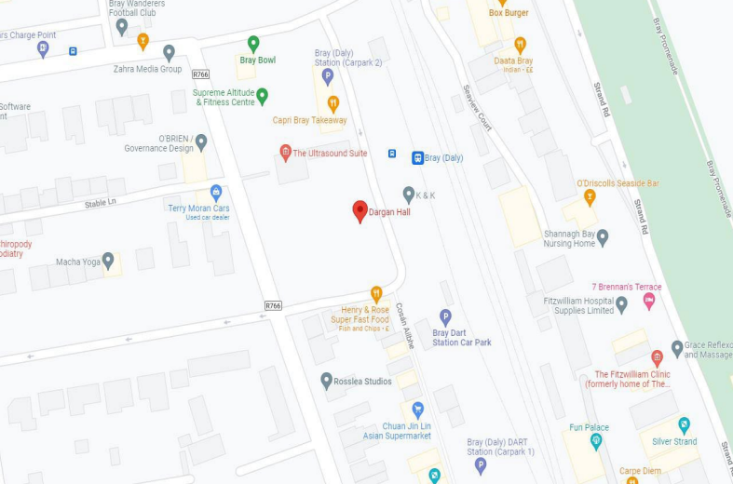
Adelaide Road, Bray
Quoting rent
Rent on application.
BER
Exempt
Term
The subject units are available on a long leasehold.
Rates
Rates are yet to be confirmed.
Service charge (2022)
Unit 1 - €955
Unit 2 - €1,315
Unit 3 - €1,365

